Slide 1

The AI Disruption We've Been Waiting For Has Arrived
Week of March 15
Jacob Appling

Slide 2
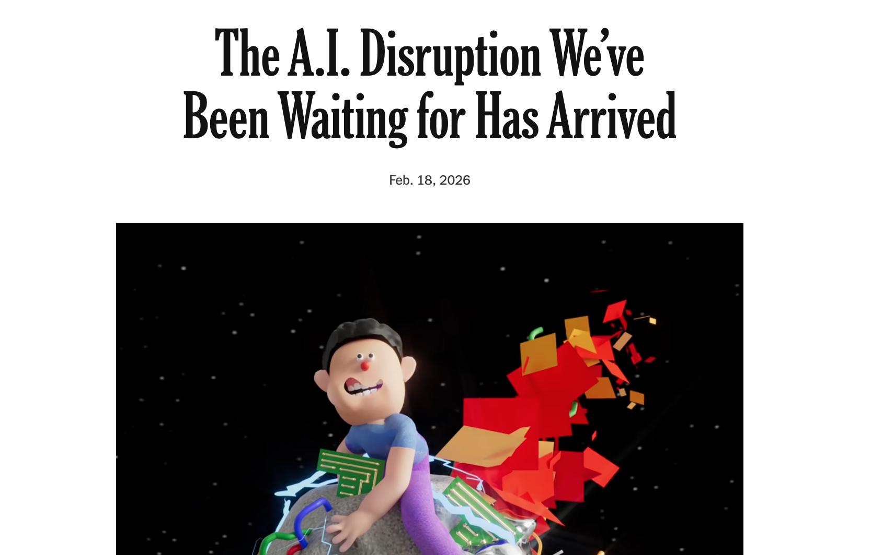

Article #4 (Row 4 via Google Sheet)

Slide 3
Link to the Source
https://www.nytimes.com/2026/02/18/opinion/ai-software.html

Slide 4
Main Findings
The article centers on “vibe coding,” which means creating software by giving prompts to A.I. tools instead of manually writing all the code.
The author argues that A.I. coding tools have improved dramatically, especially in recent months, and can now build usable websites, apps, databases, and digital tools much faster than before.
A major finding is that A.I. can complete work that once required teams of developers, designers, and months of labor, often at a fraction of the cost.
The author says the biggest disruption is not that A.I. code is perfect, but that it is often fast, cheap, and good enough to meet real needs.
The article suggests this could reduce demand for traditional software jobs, especially for coders, designers, and other technical workers whose tasks can now be automated.
At the same time, the author argues that A.I. could democratize software creation, allowing more people to build tools for themselves without relying on expensive tech firms.
The article also warns that A.I.-generated software has drawbacks, including security risks, lower quality, cookie-cutter solutions, environmental costs, and worker burnout.
Overall, the author presents a mixed view: A.I. coding is exciting and empowering, but also destabilizing and threatening to existing industries and careers.

Slide 5
Broader implications for society
A.I. may reshape white-collar work far beyond software, affecting legal services, finance, insurance, real estate, healthcare, and project management.
The technology could make many professional tasks faster, cheaper, and more accessible, especially for individuals and small organizations with limited budgets.
More people may gain the ability to create their own tools, dashboards, reports, and apps, which could increase productivity and innovation.
However, the article suggests society may also face job displacement, as many current roles may no longer be needed in the same way.
The author raises concerns about lack of regulation and governance, arguing that the pace of A.I. development is moving faster than public policy.
There are also concerns about environmental impact, since large A.I. systems rely on data centers that consume major energy and water resources.
The article implies that society is entering a “brakeless era” where technological change is happening rapidly, whether people are ready or not.
In the long term, the author believes the tradeoff may be worthwhile if A.I. helps people get better tools, better systems, and less frustrating software in everyday life.

Slide 6
Relevance and potential influence on the construction industry
The article is highly relevant to construction because the industry depends on software, project tracking, reporting, scheduling, and coordination tools that are often slow, expensive, or difficult to customize.
A.I. could allow construction firms to create custom dashboards, field reporting tools, safety trackers, cost databases, equipment logs, and project management apps much more quickly and cheaply.
Smaller contractors and firms with limited budgets could benefit by using A.I. to build tools that were previously only affordable to large companies.
A.I.-generated tools could improve communication between field teams, project managers, estimators, and owners by making information easier to collect and share.
The technology could help firms automate repetitive administrative work such as document organization, reporting, data migration, and workflow tracking.
In safety and operations, A.I. could support faster analysis of incidents, trends, inspections, and compliance data, helping companies make quicker decisions.
However, construction companies would still need human oversight because A.I.-generated tools may produce errors, insecure systems, or poor solutions if used without review.
The article suggests that construction professionals who learn to use A.I. effectively may gain an advantage, because they can build or improve tools themselves instead of waiting on outside vendors or IT departments.
Overall, the potential influence on construction is significant: A.I. could reduce software costs, speed up innovation, and improve decision-making, but it will also require careful management, training, and quality control.

